Slide 1


Indy QA Regression Approach

Slide 2
Overview
This document represents the Know-how of Regression testing process covering the following aspects :
Regression Approach
How Sprint Regression suite is created
How are Regression scenarios created in Azure DevOps
What is Mini Regression and how to identify critical scenarios.
Release Regression approach
Regression Defects Triage process
Test Results Approval
Regression Execution Schedule
Regression suite Optimization
This document will be used by SDETs involved in testing and analysts team.

Slide 3
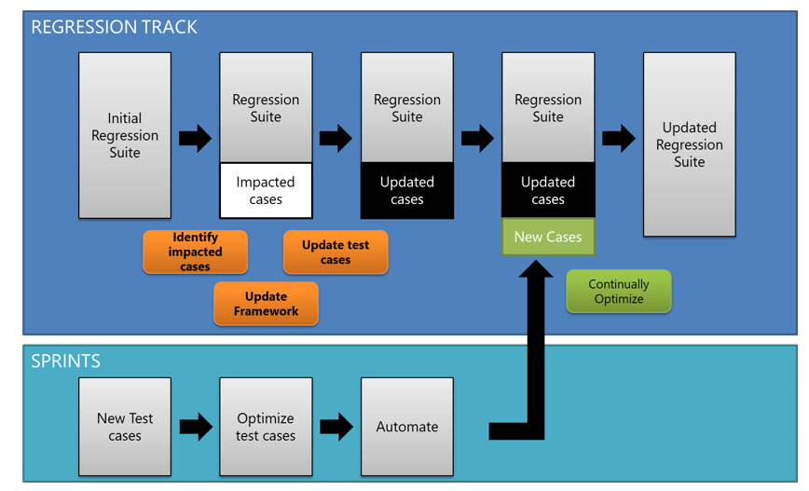
Regression Approach
RELEASE REGRESSION
Sprint 1 Regression Suite
Sprint 2 Regression Suite
Sprint 3 Regression Suite
Sprint 4 Regression Suite
Initial Regression suite is Release Regression suite which will be progressively built from Sprint Regression suites.

Slide 4
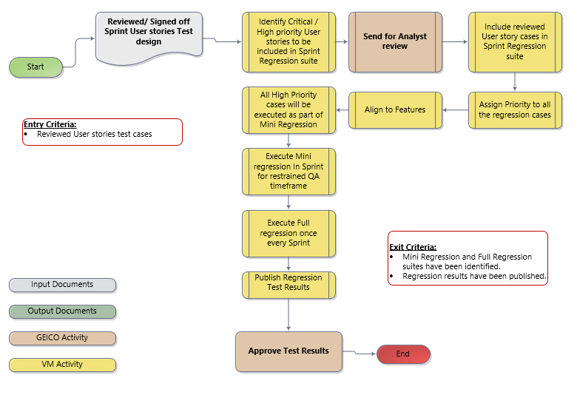
Sprint Regression Suite Creation Approach
In a Sprint , Functional tests are designed for user stories.
Regression suite should comprise of Critical / High priority user stories.
Progressively Sprint regression suites will be segregated into Features.
Mini regression: is a subset of the full regression suite comprising critical functionality that must pass before signing off on a Sprint/Release.

Slide 5
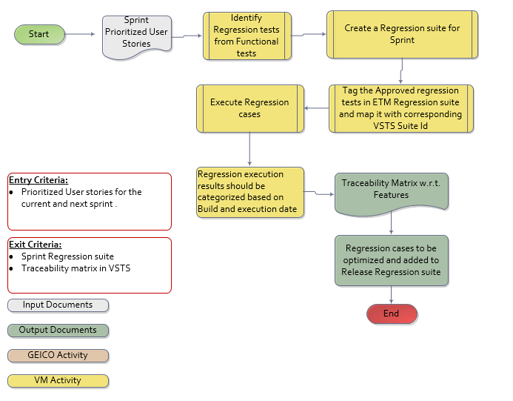
Regression Scenarios Test Design in Azure Devops
Criteria to identify Regression cases
Include cases which verify the core functionality of application
Scenarios which have failed during functional testing
Scenarios which are critical to business
Scenarios which have undergone changes recently
Scenarios which deal with third party systems or Integration touch points
Negative scenarios or real time scenarios which are mostly used by end customers
Email Transactions / Scenarios which will trigger alternate flows in the system
Discuss with Application Owner and understand the Risks and High priority scenarios

Slide 6
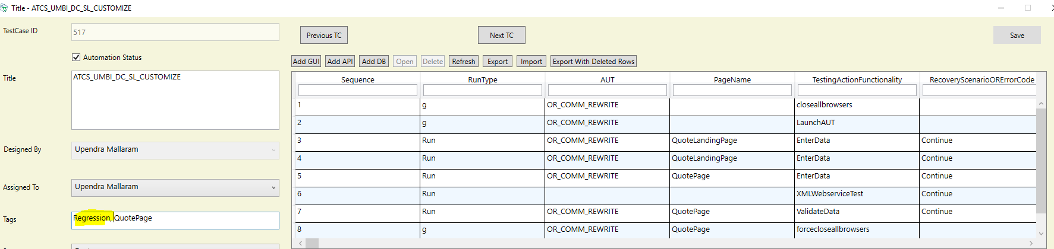
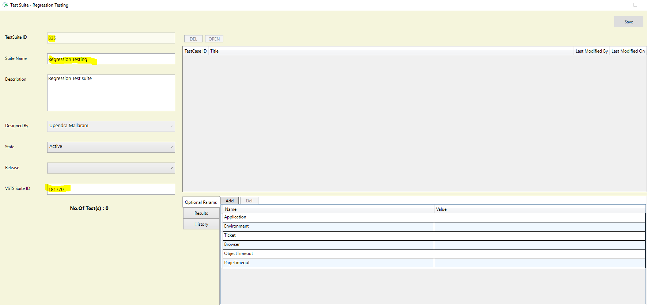
Regression Scenarios ETM to Azure DevOps mapping
Identify corresponding Azure DevOps Regression test cases in ETM by adding Tags as “Regression” and save the test case.
Create a Regression Test Suite Name in ETM with name as “Regression Testing” and the Azure DevOps regression suite ID (181770) in VSTS suite ID field.

Slide 7
Mini Regression and How to Identify Critical Scenarios
Mini regression: is a subset of the full regression suite comprising critical functionality that must pass before signing off on a Sprint/Release. This is built based upon the functionality that is critical and which is derived in consent with the Analysts. Mini Regression is only used in place of full regression due to time and resource limitation.
How to Identify Critical Scenarios:
User stories marked as critical
Feature level e2e tests (combined from one or more scrum teams working on that feature)
Acceptance criteria that are focused on business rules not field level UI validations
Impacted changes in the features or user stories that are marked in that Sprint
Features or user stories having more defects
Edge cases – covering positive and negative tests
Features that are integrated with external systems or downstream

Slide 8
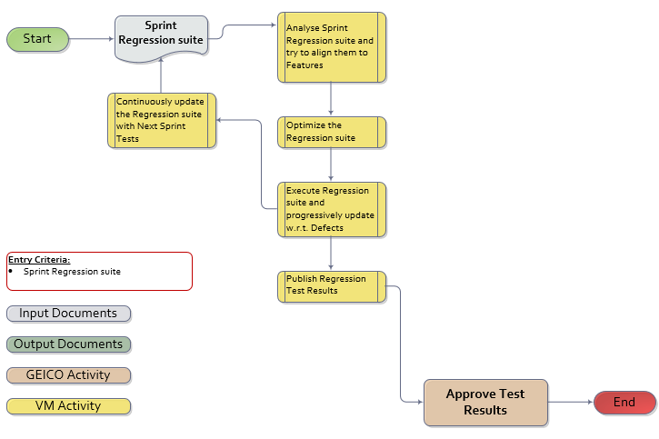
Release Regression Suite Creation Approach
Release regression suite will comprise of regression cases from multiple Sprints.
Multiple Sprint Regression suites will be combined and optimized to align with Features.
Regression suite will be updated every sprint .

Slide 9
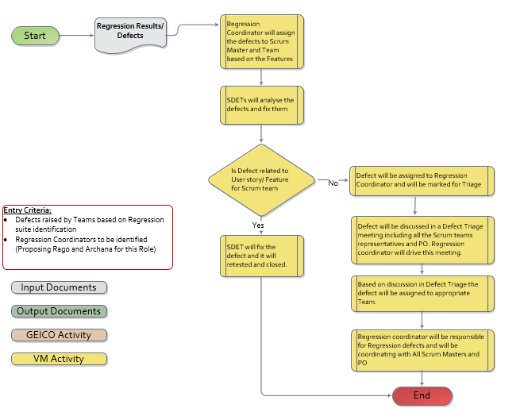
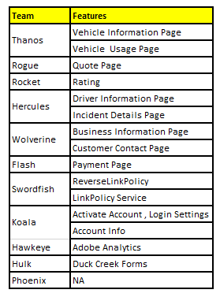
Regression Defect Triage process
Regression defects raised by the team will be mapped to respective teams according to per Feature Team mapping.
Regression coordinator will be responsible for Defect Triage and following up with PO and Scrum masters.

Slide 10
Test Results Approval
After running the Regression , team will publish the regression results along with Failures and defects .
QA team will try to associate each defect to its corresponding feature based on their understanding.
Analysts to review the test results and close the User stories after approving the results .
Scrum Master and SDET’s to accept the defects and assign it to respective SDETs and plan to fix the defects .
In case of decision being made to defer the defect , defect closure needs to be monitored by Regression coordinator along with Scrum Master.

Slide 11
Regression Execution schedule
Scrum teams tests functionality delivered as part of the scrum team .
Once the Scrum Teams are good with the Functional testing , Full Regression to be executed.
At least 70% of code should be available & Functional testing should be completed to run a full regression on 2nd Day of 2nd week in a Sprint.
In case of <70% code availability in 1st Week , team will execute a Mini regression on last day of first week of Sprint.
Team to conduct a Full regression for Sprint N in First week of Sprint (N+1) in case the deployments are not available on time during the Sprint.

Slide 12
Regression Suite Optimization Approach
Identification
Merging and Organization
Execution & Validation
Progressive Addition of Cases
Prioritization
Scrum test teams tests functionality delivered as part of the scrum team
Test cases across scrum teams are stringed together based on navigation flow and scenarios to form a complete flow of a feature
Test cases formed will be prioritized & mapped based on feature in VSTS.
All identified test cases will be traceable to user stories.
Finally, continuous testing suite will be shared with Analysts / Product Owners / Scrum master and feedback (if any) will be incorporated

Slide 13
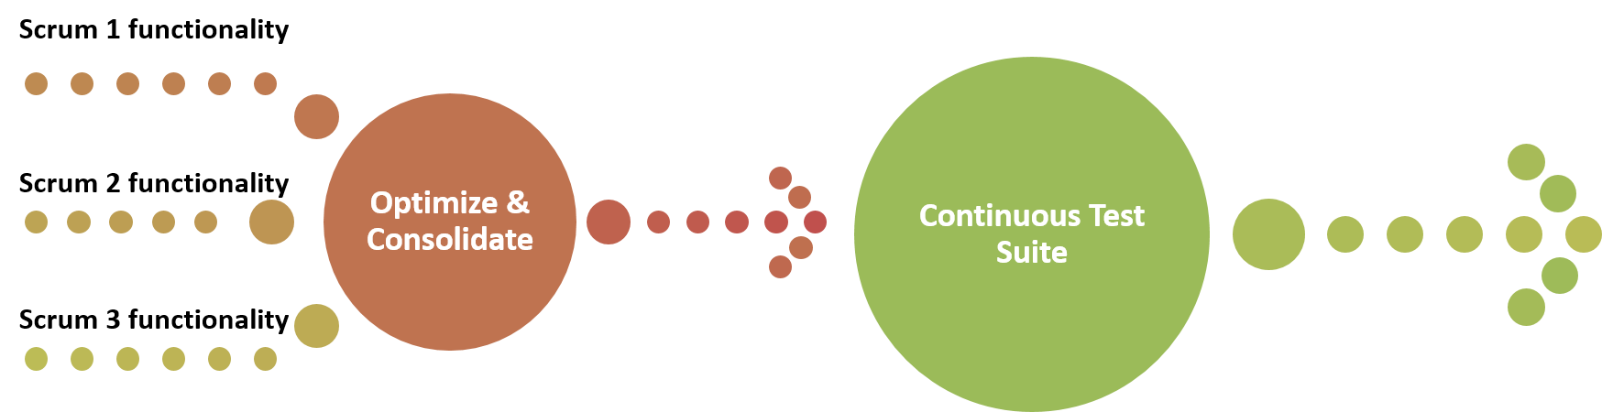
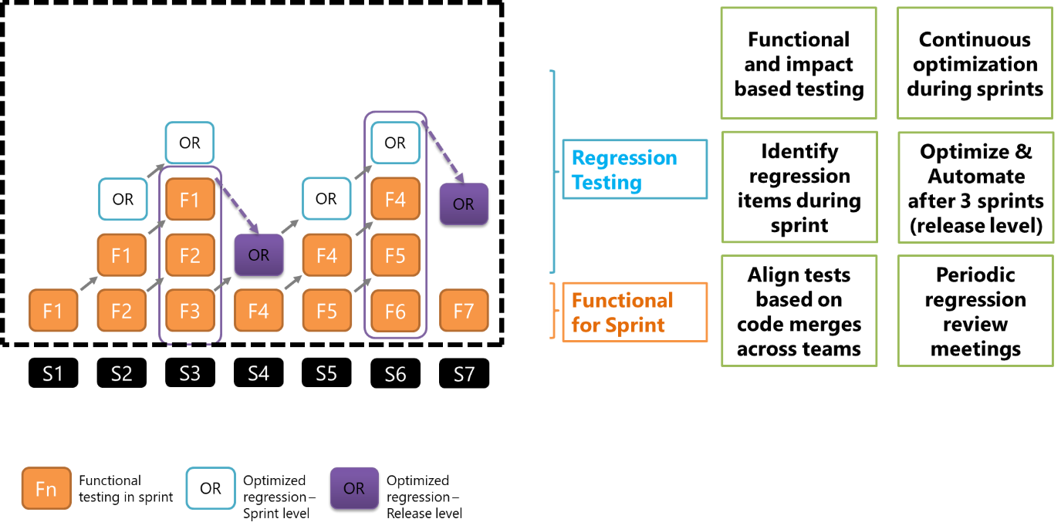
Regression Suite Optimization Approach contd..
Scrum 1 , Scrum 2 functionalities will be consolidated and Optimized in alignment with the Features.
Regression suites will be executed in nightly builds for Full regression and Impacted Tests.

Slide 14
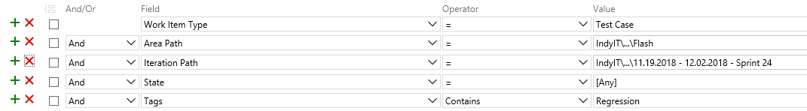
FAQs
Q1: How do I create Regression test cases for a User story or a Feature in Azure DevOps ?
Ans: Team will identify the regression cases for User story in a Sprint and add a tag : “Regression”.
Q2: How do Identify Regression test cases for a Scrum team in Azure DevOps ?
Ans: Search Azure DevOps with below defined parameters in the query.

Slide 15
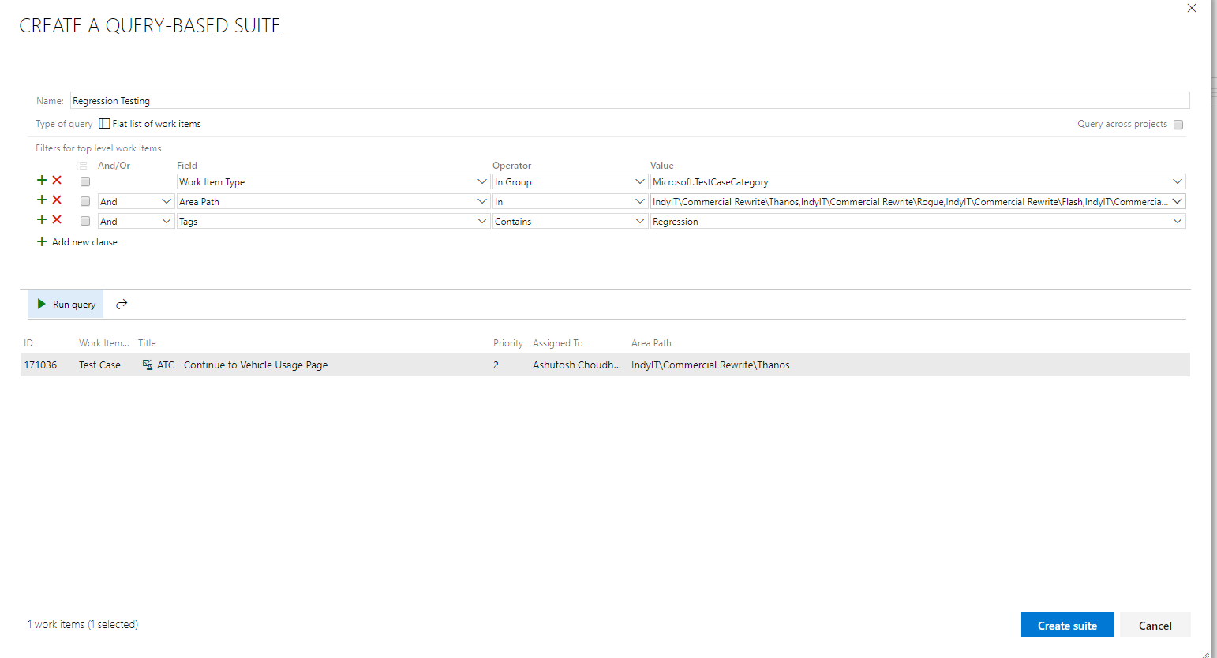
FAQs
Q3: How do I create Regression test suite in Azure DevOps?
Ans: Create a Query Based Test suite in the test plan with Tags contains “Regression” (Test Suite ID: 181770)

Slide 16

THANK YOU!
Email: solutions@valuemomentum.com
ASIA PACIFIC
Plot No 36 & 37, Gachibowli,
Financial District, Nanakramguda
Hyderabad- 500032, India
Tel: +91 40 66509300
US HEADQUARTERS
220 Old New Brunswick Road
Piscataway
NJ 08854
Tel: (908) 755 0048

